Slide 1
AI-Powered Personal Finance Assistant
Deployed application on Hugging Face Langflow Flow Design

Slide 2
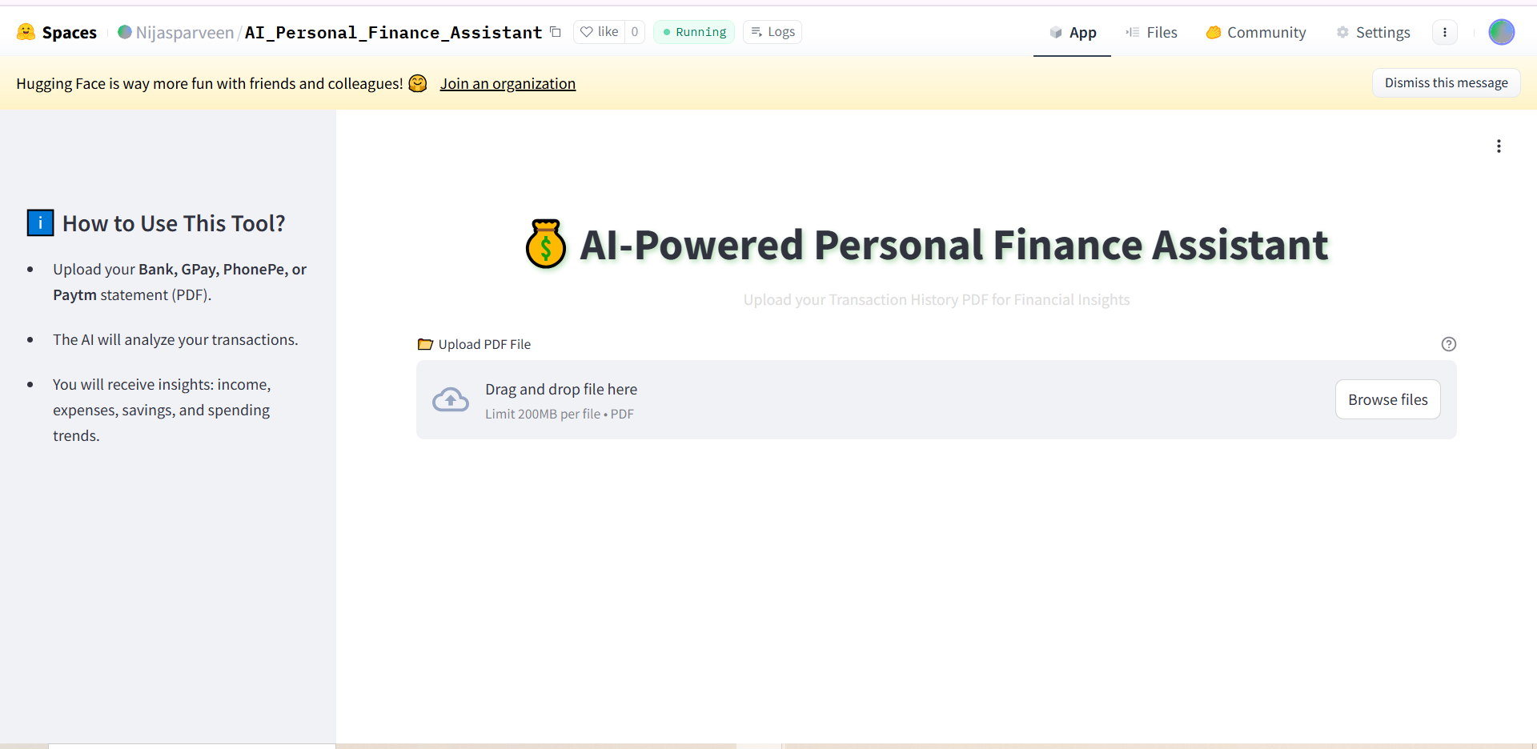
This project leverages LLMs to transform raw transaction data into meaningful financial insights, enabling smarter money management.

Slide 3
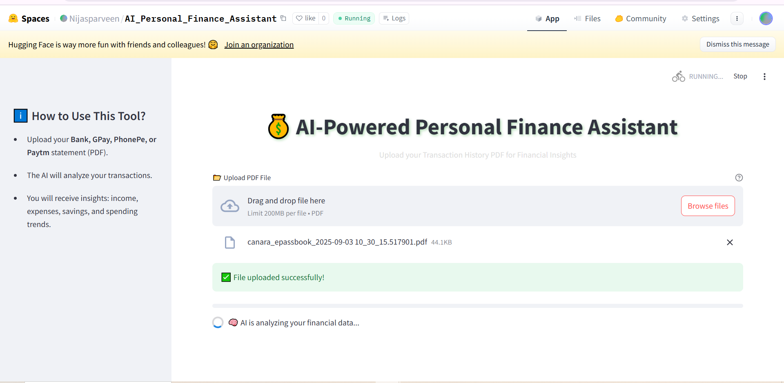
Uploaded statements are analyzed to extract income, expenses, savings, and spending trends.

Slide 4
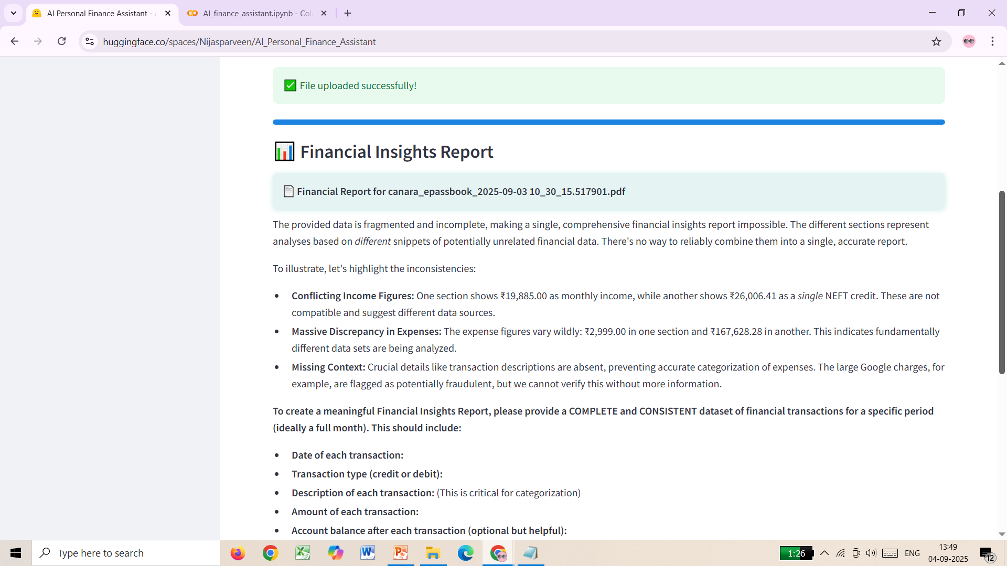
Generates a detailed report with categorized expenses, income summary, savings percentage, and personalized recommendations.

Slide 5
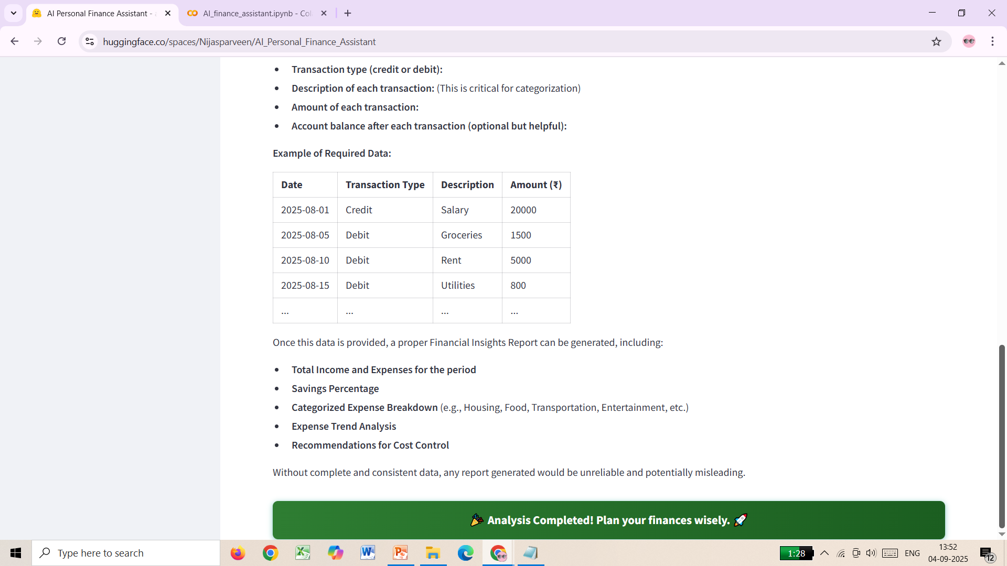
Detailed report

Slide 6
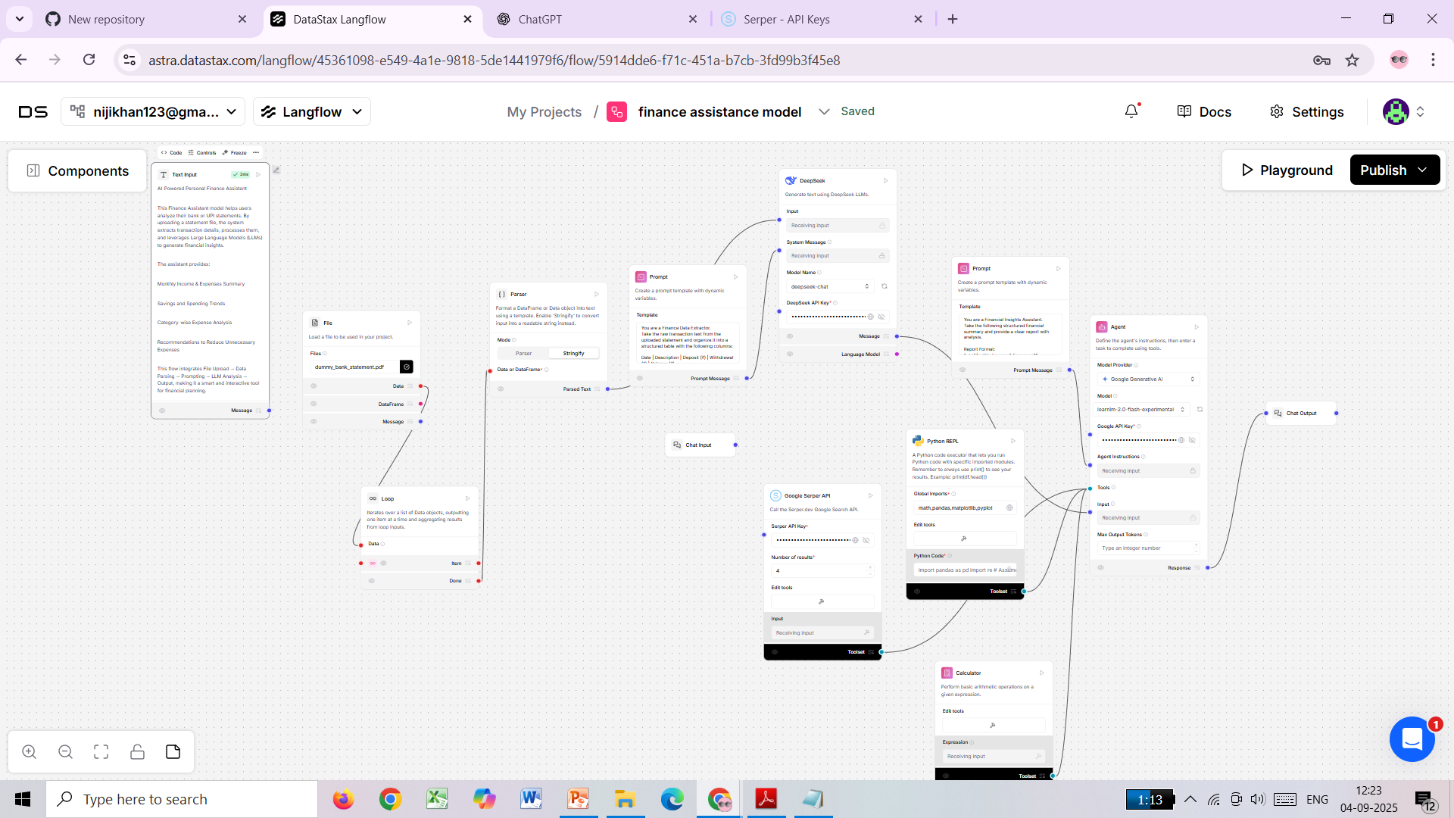

Slide 7
Langflow Flow Design – Finance Assistant
As part of the project, I designed a Langflow model to analyze financial statements.
The flow consists of:
File Node – for uploading bank/UPI statements (PDF).
Parser Node – extracts and structures transaction text.
Prompt Node – instructs the LLM to analyze income, expenses, savings %, trends, and unnecessary spending.
LLM Node (Google Generative AI / Cohere) – processes the prompt and generates financial insights.
Agent Node with Tools – integrates Python REPL, Calculator, and Serper API for additional computations and analysis.
Chat Output – displays the insights back to the user.

Slide 8
Thank you

